Slide 1
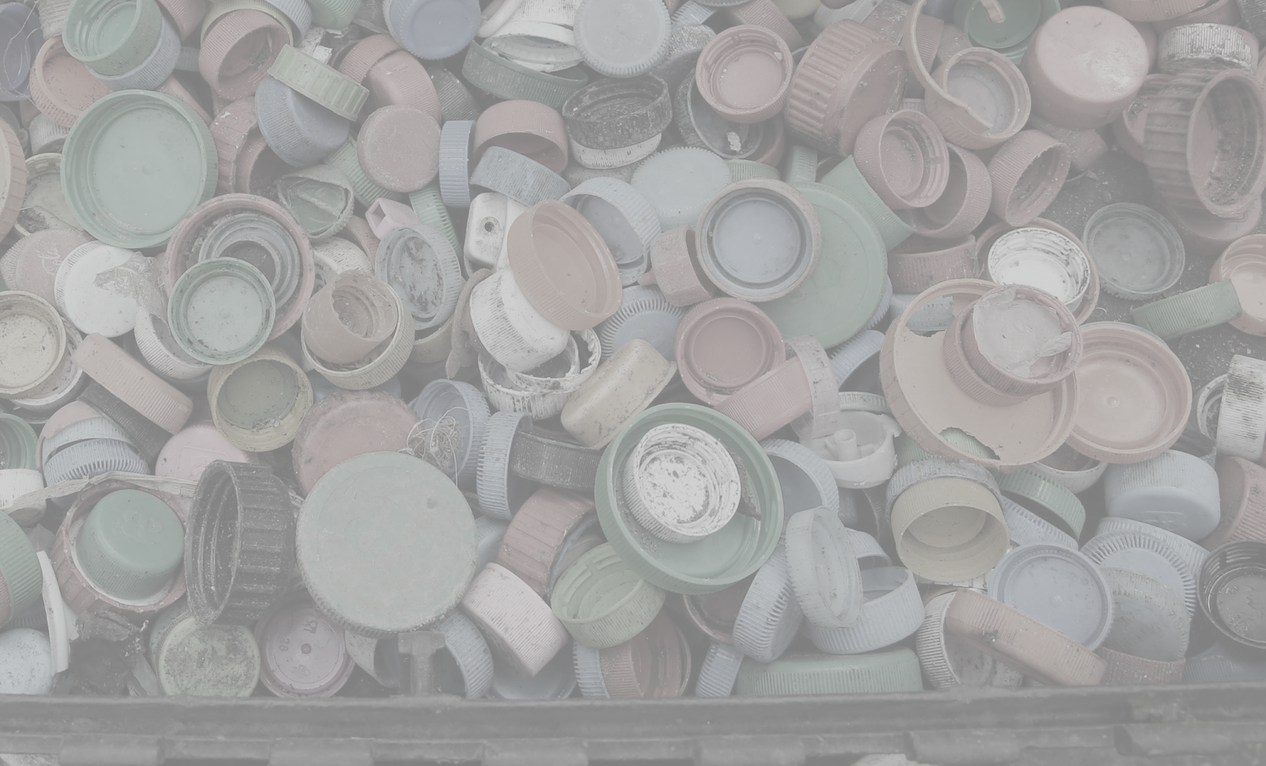
Green Team Presentation

Slide 2
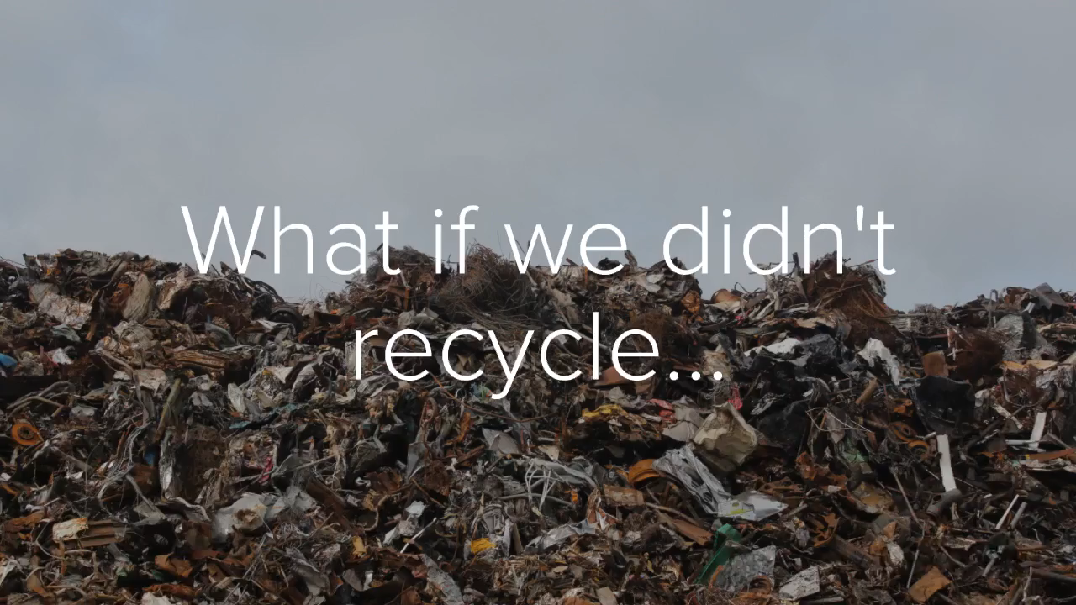

Slide 3
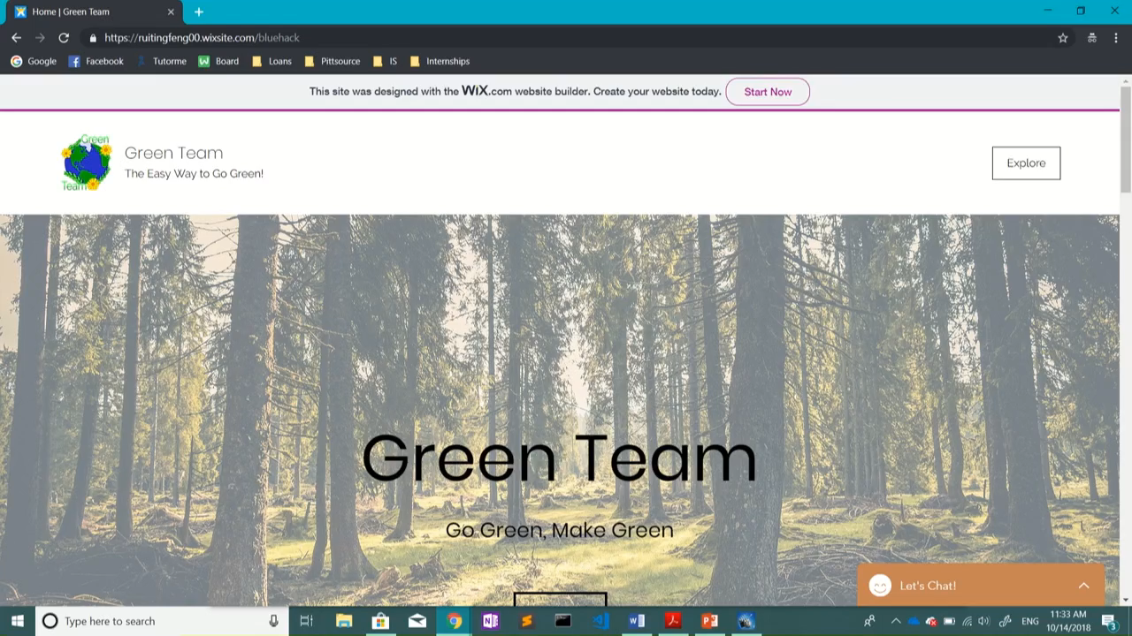

Slide 4

Green Team’s Product
Features/Products:
RFID system
Data stored into cloud Crashplan
Raspberry Pi
Recycling in conjunction with local pick-up system
Customer Base
Pittsburgh, focusing on Oakland, Shadyside and Squirrel Hill

Slide 5
Green Team’s Value Proposition
Local City/Municipality
Cleaner/more environmentally friendly city.
Department of Environmental Protection provides economic incentives (grants) to cities based on how much they recycle.
Chain Companies
Increase in customers due to points system.
Everyday People
People that already want to recycle: Feel better about themselves, earn points that they can spend at local companies (eateries, clothing etc.)
Increased knowledge on how to properly recycle.

Slide 6
Sources of Revenue
Sponsors from companies
Companies pay for advertising
Their coupons to put into our app
Charge them business advertising fees and affiliate fees
Ads in app
Points toward coupons to use toward a company
Banner ads
QR sticker sales
People need to buy a QR code with RFID chip to put on their recycling bins to scan for pickup.

Slide 7


 | iRecycle | Recycle Nation | Us
Offers location services to find your nearest recycling center
Allow user to discover if a certain material is recyclable?
Directly works with local government to make recycling more prevalent in their communities
Provide Incentive to increase recycling
Tracks recycling

Slide 8
Sources of Financing
Enter product into Innovation competitions to raise awareness and meet startup costs
i.e. Randall Family Big Idea Competition, PiNCh, etc.
Apply for funds from Innovation Works in Pittsburgh
Technology-based startups in Pittsburgh
Grants from the government
EPA’s P3 Program
Especially for students
Rockefeller Brothers Fund Sustainable Development

Slide 9
Obstacles/Future Milestones
Obstacles
Initial costs:
Raspberry Pi (200 dollars per truck)
Clash plan (10 dollars per month per truck)
Reliance of cooperation of local recycling companies
Future
Begin in Oakland, Shadyside and Squirrel Hill
Expand throughout the rest of Pittsburgh
Prize money will manage startup costs

Slide 10
Questions?

Slide 11
References
http://www.post-gazette.com/local/city/2015/06/03/Recycling-of-solid-waste-continues-to-grow-in-city-but-still-short-of-goal/stories/201506030145
https://www.statista.com/statistics/695426/americans-participating-in-recycling-in-the-united-states/
https://www.scientificamerican.com/article/is-recycling-worth-it/
https://arstechnica.com/information-technology/2017/02/new-10-raspberry-pi-zero-comes-with-wi-fi-and-bluetooth/

